Slide 1

PRODUCT SHOWCASE: DEFINING END-TO-END RECRUITING
Presented by Bennett Sung, Head of Marketing
11 October 2018

Slide 2


Slide 3

A UNIQUE CANDIDATE HIRING CLIMATE
10-Year Record Low Unemployment of 3.7%
10-Year Record High Quit Rate of 62%
How are you driving efficiency while delivering a great candidate experience?
Notes:
Economical:
What does the hiring climate look like today?
Climate of supply and demand.
The available workforce is into 3 buckets:
The unemployed is at an all time low at 3.7 in Sept 2018 (Source: The National Employment Monthly Update) A 10 YEAR low.
For every job opening there is 1 unemployed worker. (Source: Reuters)
Quit Rate 62% compared during the recession 2008-2009 which was 35%

Slide 4

By 2020 the early career talent generation will make up nearly 50% of the workforce.
92% of early career talent owns a smartphone
How well aligned is your engagement strategy with the early career talent pool?:
Notes:
Generational Climate:
Fill the top of the funnel, phone, web chat, expanding to bring in more people. People who may have been isolated from the hiring process because they didn’t want to fill out a form. Sheer volume because it is a modern approach to filling a job. STATS of Millenial and Gen Z
This early career talent pool

Slide 5

Screen & Assess
Onboard & Check-In
Job Search & Apply
THE HIRING JOURNEY
Schedule & Interview

Slide 6


Major Shift In Experience & Automation
Desktop / Kiosk
Forms
Wait Time
17 Minutes To Apply
Business Hours
Mobile / Text
Conversations
Engage Now
3 Minutes To Apply
24x7 Candidate Support
Notes:
The traditional hiring vs conversational AI Recruiting: 5 core thing that contribute to poor experience and efficiencies
ATS: Re-imagined - But there are still things that they do not do
What does your recruiting technology fail to address today?
These are the things that we spotlight:
Job Search and Apply
Screen & Assess
Schedule
Onboard
Retention
Talking points:

Slide 7
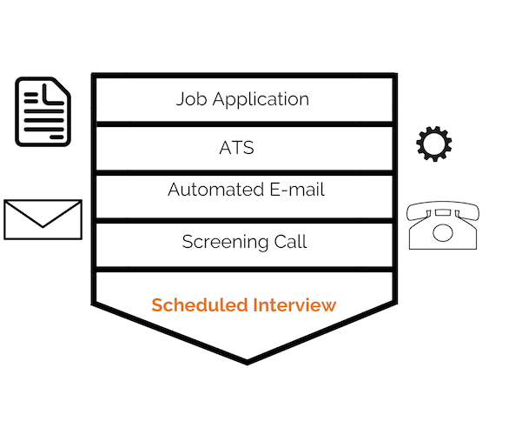
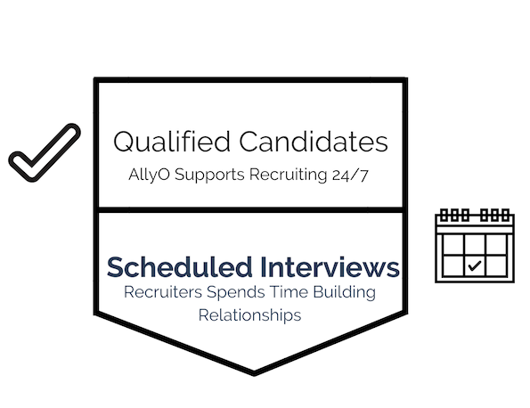


TRADITIONAL RECRUITING PROCESS
CONVERSATIONAL A.I. RECRUITING PROCESS
CANDIDATE
CANDIDATE
Notes:
Here is the traditional process
The new conversational process
We focus on is efficiency
This shift in process automation is why we are able to accelerate KPI’s
This shift in paradigm is how we rapidly improve cost to hire (cost and time)
This also helps a staffing agency, handle more candidates, more placements, more revenue
Re-structure and give back 20% of their day - because AllyO has done all this work for them
They can really understand the motivation behind the candidate
This is the power of recruitment automation
Calendar Tetris
Conversational AI you can hire at SCALE
Imagine you walk into work with qualified candidates already scheduled and ready to go
Transitions to looking at how AllyO in action...

Slide 8







END-TO-END RECRUITING WORKFLOW NEEDS
Talent Pool Engagement
Capture & Apply
Screen & Assess
Schedule
Interviews
New Hire Check-Ins
Employee
Referral
Notes:
Our vision is to become the AI platform for recruiting. End-to-End is the comprehensiveness of Engagement, Automation and Intelligence.
We are going to showcase

Slide 9

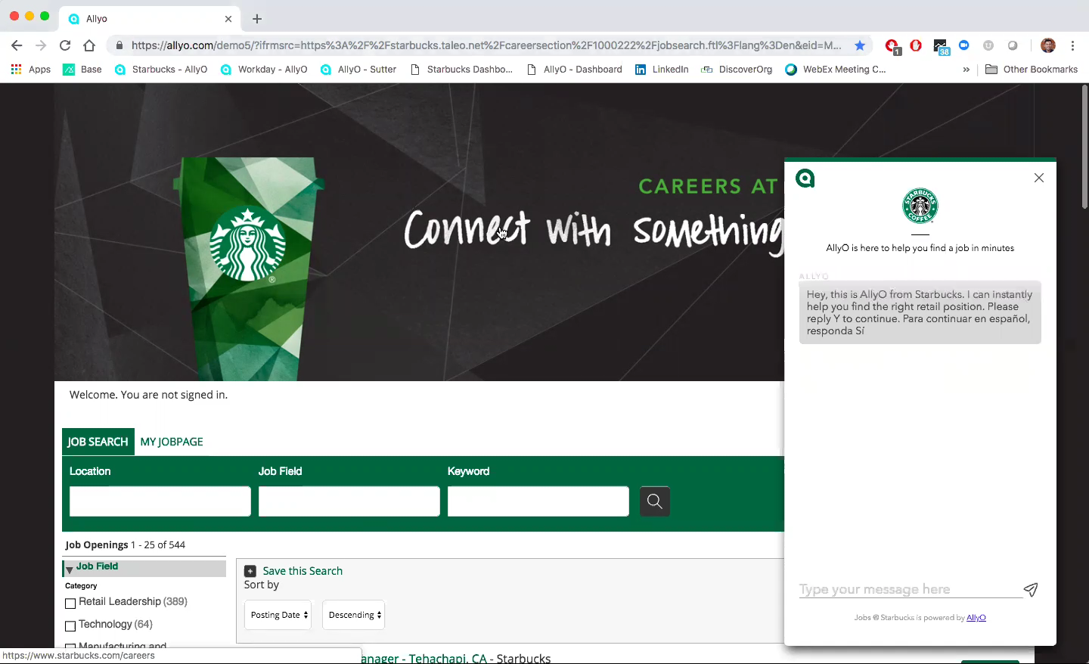
From Forms to Conversations
Engage With 100% of Candidates
Notes:
The Solution:
AllyO's Capture and Apply feature will help companies:
Attract, engage and organize potentially interested job applicants
Direct potentially interested job applicants through a seamless, informative job apply process within minutes
Capture new applicant leads for their ATS, increasing the reach of their talent community
Increase overall qualified applicant volume, ensuring best practices are constantly evolving and growing

Slide 10

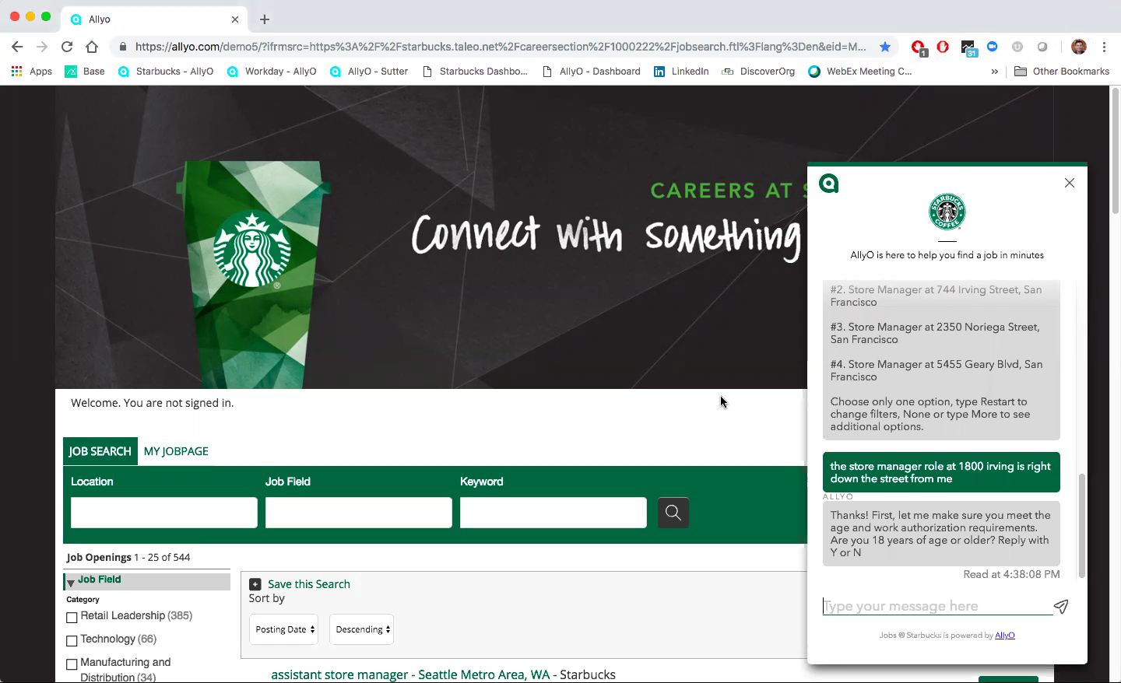
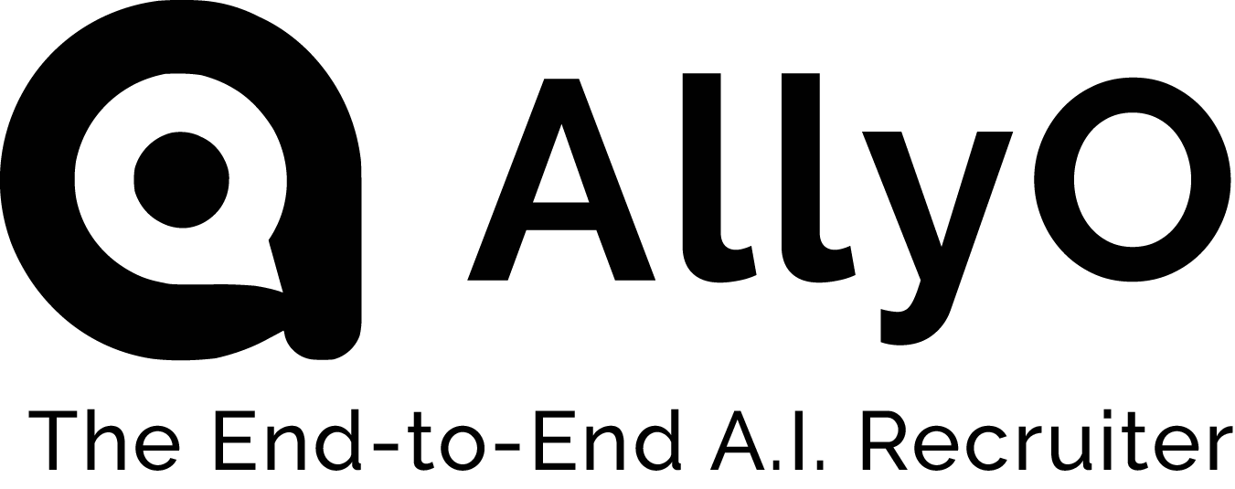
Identify Best-Fit Candidates
Increase Your Interviewable Applicant Pool by 6X
Notes:
We are able to increase your interviewable applicant pool by 6X because
Voice, video, and text based assessment tools built within AllyO
Vendor consolidation is more cost effective and time efficient
Creates a seamless applicant experience
Real time assessments rather than sending the recruiter an email and talking 3 days for them to respond to inquiries.
Screening for High Volume roles is most effective post ATS.
Show the Post ATS sprouts demo video.
Screening is configured differently for every requisition
The way you screen a sales person is different than the way you screen a data scientist
Proprietary job data extraction tool that allows us to do 98% of the heavy lifting in terms of programming the bot. Your team just makes edits.

Slide 11

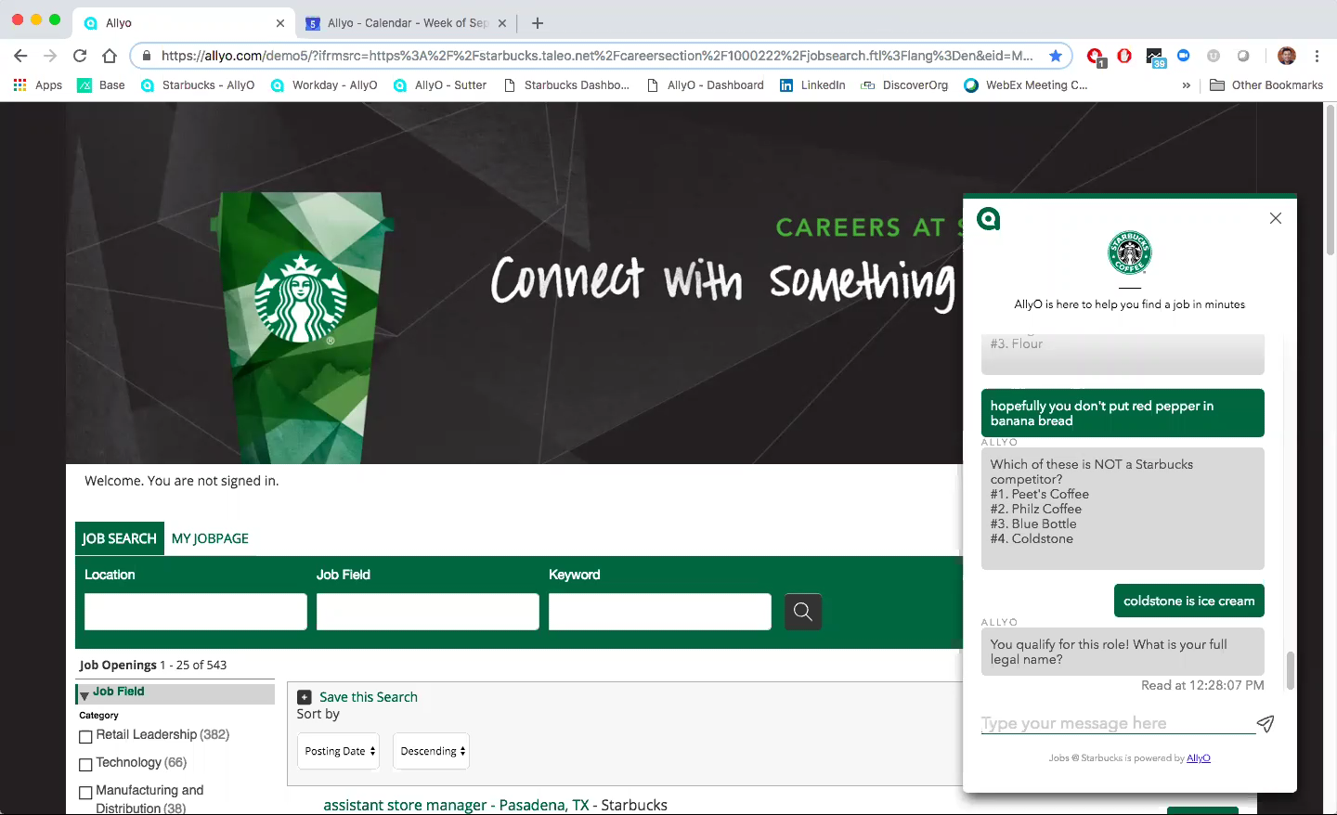




Today, we can standby on auto-pilot as qualified, interested applicants walk in for interviews when managers are available.” Sivan Aballi, Operations Leader, FIVE GUYS
Notes:
Auto interview scheduling of qualified candidates, based on recruiter/hiring managers calendar availability
Full integration with Office 365 & G-Suite, with light integration into Microsoft Exchange.
One click reschedule will notify candidate and offer new, open slots
Multiple interview types: 1-1, panel, sequential, group, and more!
The TA team will no longer have to waste time reaching out and confirming availability with candidates and hiring managers
Immediate feedback/outreach/interview scheduling leads to faster hires
Keep the candidate engaged, and get them in front of the right people while their interest in the role is highest

Slide 12

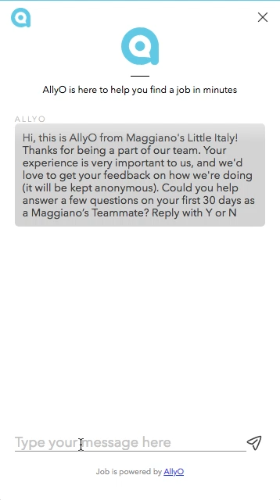
Transform The Retention Equation
Achieve 2X The Industry Average Response Rate
Notes:
Candidate Journey/Recruiter: Retention & New Hire Check In
Every new recruit is an investment, and making sure they are engaged early can provide valuable ROI when it comes to employee retention. Feedback transforms the retention equation.
Onboard & New Hire Check In
Desktop Engagement vs Text Engagement
On New Hire Checkin we can talk about 2x the industry average response rate.
We should also speak to our ability to identify changes in employee happiness over time by location/role/hiring manager.
Capabilities:
Run periodic 30, 60, 90 days check-ins via text and web-chat to mitigate churn and generate actionable insights
Improve onboarding process with new hire communications and reminders for onboarding trainings and day 1 orientations, etc.
FAQs:
How do you initiate the new hire check in? Integration with ATS change of status triggers that after x number of days (depending on API integration), otherwise CSV upload
Does this update in the ATS? Depends on the ATS, yes for Successfactors and Taleo, others “we’ll look into it.”

Slide 13
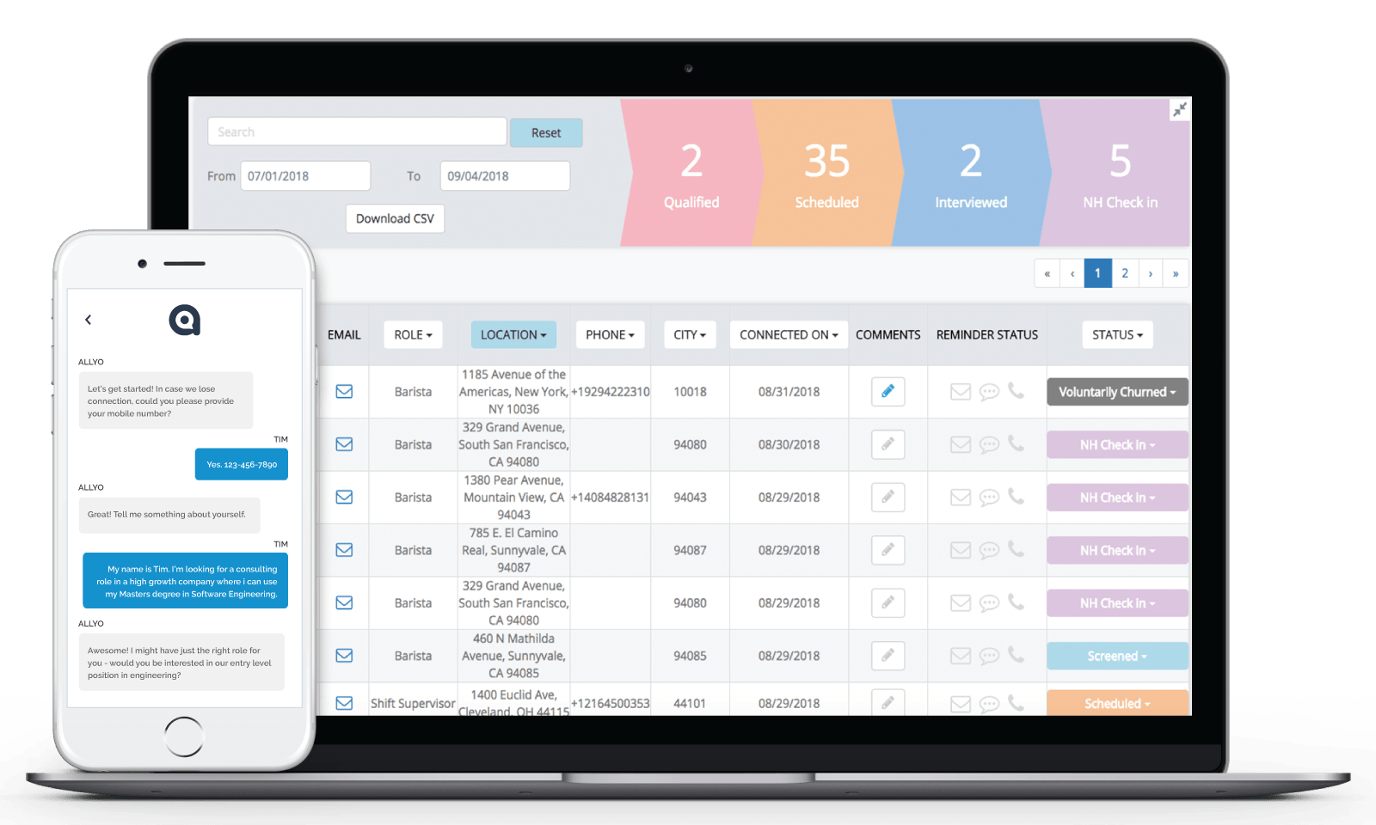
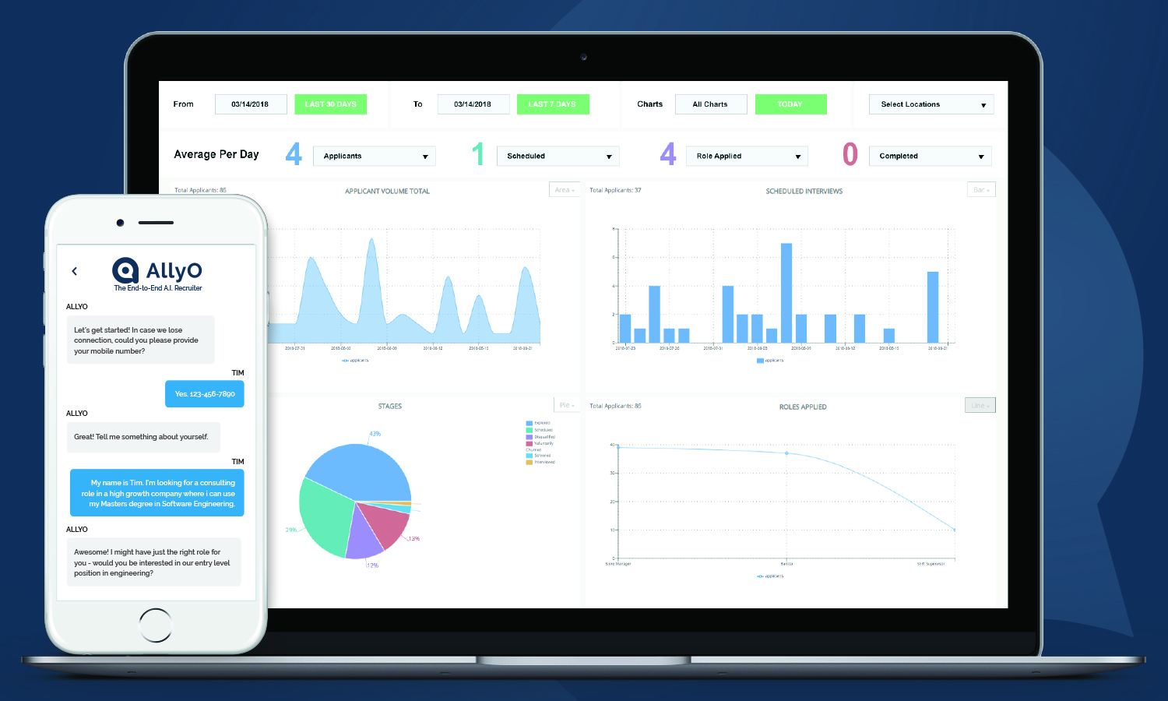
Notes:
Collect and analyze applicant data

Slide 14
Notes:
Collect and analyze applicant data

Slide 15


“AllyO conducts post
interviews of all our
call center applicants,
scheduling the selected
few for final offer-extension
calls. This easily saves us 15
minutes of manual work on
each applicant, speeding up recruiting and lowering costs significantly.”
Amber Weaver Director of High Volume Recruiting
Notes:
KEY DIFFERENTIATORS
AllyO is the ONLY End-to-End
Works with your unique recruiting workflows and tech stacks
Captures candidates across all channels (existing ATS, employee referral, normal advertising channels)
Secure, scalable and fast to deploy (set up process)
Trusted by large enterprise brands
Awards: Gartner, HR Exec

Slide 16







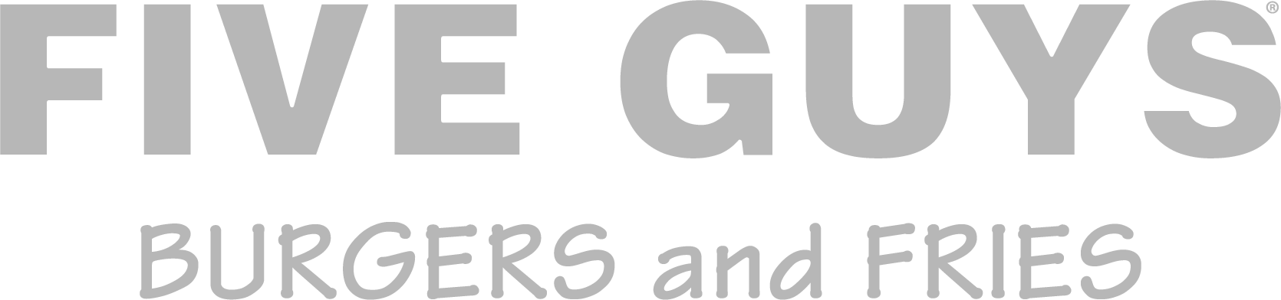








delightful & efficient
94%
2
Application Completion
days per week recruiter time saved
92%
< 5%
Candidate Satisfaction
applicants require human help
97%
100%
Customer NPS
Applicants served

Slide 17
MAKING RECRUITING DELIGHTFUL AND EFFICIENT FOR EVERYONE
Talent Pool Engagement
Capture & Apply
Screen & Assess
Schedule
Interviews
New Hire Check-Ins
Employee
Referral
The End-to-End A.I. Recruiter
only

Slide 18


Ask me about our Pilot Program via email: bennetts@allyo.com
Bennett Sung Head of Marketing e: bennett@allyo.com /in/bennettsung @bennettsung
Raahul Srinivasan Product Manager e: raahul@allyo.com
www.allyo.com | Text “Demo” to 404.205.8587 linkedin.com/company/allyo | @ApplywithAllyO

